Slide 1
12584 – The Beauty of Distributing

Slide 2
Description
Little Brick has N magic reels (魔法卷軸) that can increase skill level (技能等級).
The ith reel can increase the skill Xi levels.
Little Brick hopes to use all reels and :
Learn as many skills as possible.
Every learned skill must be at the same level.
That is, to distribute all reels into as many groups as possible, and make the sum of each group the same.
翻譯白話文:每個欄位的內部總和相同，而且欄位數目越多越好。但是要注意，每個欄位內部的分配不一定相同

Slide 3
Input
Multiple test cases,
The first line represent the number of test cases.
In every test case,
The first integer N represents the number of reels.
The second line contains N numbers,
Each number Xi means ith reel can increase Xi levels.

Slide 4
Output
For every test case, output one integer,
which is the maximum number of skills that Little Brick can learn.

Slide 5
Sample Input & Output
Input:
3
6
1 1 2 2 3 3
5
1 1 2 5 3
3
1 2 4
Output:
4
2
1

Slide 6
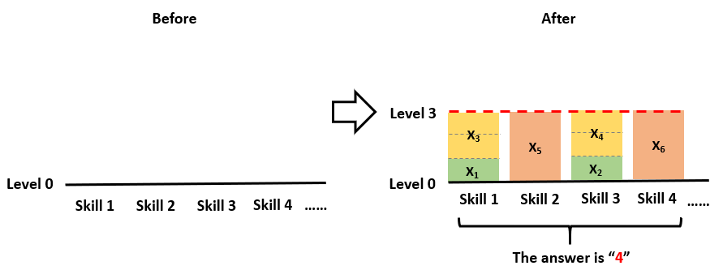
Sample 1
N = 6, reels = 1 1 2 2 3 3
Answer = 4
Skill levels: (1, 2), (3), (1, 2), (3)

Slide 7
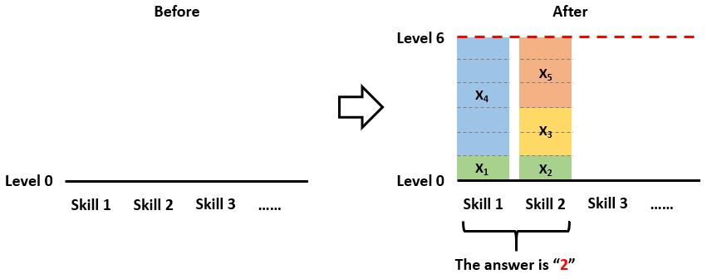
Sample 2
N = 5, reels = 1 1 2 5 3
Answer = 2
Skill levels: (1, 5), (1, 2, 3)

Slide 8
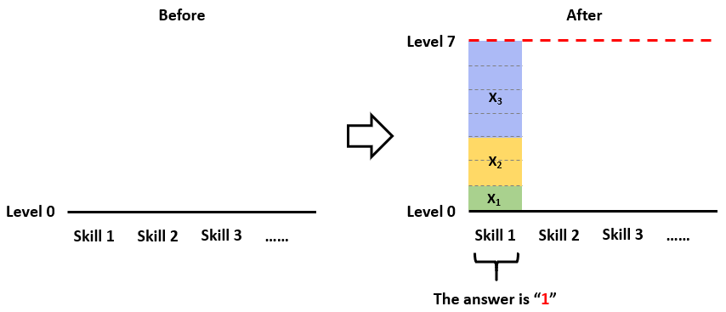
Sample 3
N = 3, reels = 1 2 4
Answer = 1
Skill levels: (1, 2, 4)

Slide 9
Idea
The main idea is:
Distribute all reels into as many groups as possible, and make the sum of each group the same.
So, we can divide the problem to two parts:
Determine the level (size) of each skill (box).
Try to fulfill every skill’s level with the reels

Slide 10
Idea – Determine the level (1)
The sum of all skills equals to the sum of all reels, and all skills should be at the same level.
So, if we want to learn K skills,
Every skill’s level is sum / K
If the skill level sum / K is an integer, it’s legal.
So we should skip those K skills that lead to non-integer skill levels.
For example, 12 / 5 = 2.4
That is, if the sum is 12, we can’t learn 5 skills.

Slide 11
Idea – Determine the level (2)
We can imagine the skills as boxes.
And we need to use the reels to fill them.
Reels:
Skills:
3
1
6
6
1
5
2
Skill 1
Skill 2

Slide 12
Idea – Determine the level (2)
We can imagine the skills as boxes.
And we need to use the reels to fill them.
Reels:
Skills:
3
6
6
1
5
3
1
5
2
2
1
1
Skill 1
Skill 2

Slide 13
Idea – Determine the level (2)
We can imagine the skills as boxes.
And we need to use the reels to fill them.
Reels:
Skills:
3
1
No non-integer box sizes
1
2.4
2.4
2.4
2.4
2.4
5
2
Skill 1
Skill 2
Skill 3
Skill 4
Skill 5

Slide 14
Idea – Determine the level (3)
If we have N reels, then:
Best case: N skills
Ex: N = 3, reels = 1 1 1
Skills:
1
1
1
Skill 1
Skill 2
Skill 3

Slide 15
Idea – Determine the level (3)
If we have N reels, then:
Worst case: 1 skill
Ex: N = 3, reels = 1 2 4
Skills:
4
2
1
Skill 1

Slide 16
Idea – Determine the level (4)
So if we have N reels, we can:
Try skill number i from N (best) to 1 (worst)
The size of every box is sum / i
Skip those non-integer levels
No non-integer size boxes
Try to distribute the reels to fulfill the skill level.
Fill all the boxes with all reels
If success, i is the answer. If no, decrease i by 1.
Reduce box number, increase box size

Slide 17
Determine the level – Code
int main()
{
int T, sum, ans; // T: testcases, sum: total levels, ans: box number
scanf("%d", &T); // Read testcase number
while (T--) { // Read testcases
scanf("%d", &n); // Number of reels
sum = 0; // The sum of reels
for (int i = 0; i < n; i++) {
scanf("%d", &a[i]); // Level of every reel
sum += a[i]; // Increase sum
}
for (ans = n; ans > 1; ans--) { // Determine box number
box = sum / ans; // Calculate box size
if (sum % ans == 0) { // Skip non-integer box sizes
memset(vis, false, sizeof vis); // Reset vis array
if (dfs(0, 0)) break; // Try to fill the boxes recursively
}
}
printf("%d\n", ans); // The maximum box number
}
return 0;
}

Slide 18
Idea – Fill the boxes (1)
How to fill the boxes?
Use recursion.
Pick an unused reel and put it into the box.
If the box is not full yet, repeat until the box is full.
If the box full, start with a new box.
If the reel will make the level exceed, DON’T USE IT
If all N reels can be put into the boxes, then we find a solution.

Slide 19
Example
Let N = 3, reels = 1, 2, 3
So the sum = 6
The answer is 2
Skills: (1, 2), (3)
Let’s see the animated example:

Slide 20
Boxes: 3, Size: 6 / 3 = 2
()
Reels:
Skills:
1
2
2
2
3
2

Slide 21
Boxes: 3, Size: 6 / 3 = 2
()
Reels:
Skills:
1
2
2
2
3
2

Slide 22
Boxes: 3, Size: 6 / 3 = 2
()
Reels:
Skills:
1
2
(1)
2
2
3
2

Slide 23
Boxes: 3, Size: 6 / 3 = 2
()
Reels:
Skills:
1
2
(1)
1
2
2
3
2

Slide 24
Boxes: 3, Size: 6 / 3 = 2
()
Reels:
Skills:
1
2
(1)
1
2
2
3
2

Slide 25
Boxes: 3, Size: 6 / 3 = 2
()
Reels:
Skills:
1
2
(1)
1
2
2
(1, 2)
3
2

Slide 26
Boxes: 3, Size: 6 / 3 = 2
()
Reels:
Skills:
2
1
2
(1)
1
2
2
(1, 2)
3
2
Box Limit Exceeded!

Slide 27
Boxes: 3, Size: 6 / 3 = 2
()
Reels:
Skills:
1
2
(1)
1
2
2
(1, 2)
3
2

Slide 28
Boxes: 3, Size: 6 / 3 = 2
()
Reels:
Skills:
1
2
(1)
1
2
2
(1, 2)
3
2

Slide 29
Boxes: 3, Size: 6 / 3 = 2
()
Reels:
Skills:
1
2
(1)
1
2
2
(1, 2)
(1, 3)
3
2

Slide 30
Boxes: 3, Size: 6 / 3 = 2
Reels:
3
()
Skills:
1
2
(1)
1
2
2
(1, 2)
(1, 3)
3
2
Box Limit Exceeded!

Slide 31
Boxes: 3, Size: 6 / 3 = 2
()
Reels:
Skills:
1
2
(1)
1
2
2
(1, 2)
(1, 3)
3
2

Slide 32
Boxes: 3, Size: 6 / 3 = 2
()
Reels:
Skills:
1
2
(1)
2
2
(1, 2)
(1, 3)
3
2

Slide 33
Boxes: 3, Size: 6 / 3 = 2
()
Reels:
Skills:
1
2
(1)
2
2
(1, 2)
(1, 3)
3
2

Slide 34
Boxes: 3, Size: 6 / 3 = 2
()
Reels:
Skills:
1
2
(1)
(2)
2
2
(1, 2)
(1, 3)
3
2

Slide 35
Boxes: 3, Size: 6 / 3 = 2
()
Reels:
Skills:
2
1
2
(1)
(2)
2
2
(1, 2)
(1, 3)
3
2

Slide 36
Boxes: 3, Size: 6 / 3 = 2
()
Reels:
Skills:
2
1
2
(1)
(2)
2
2
(1, 2)
(1, 3)
3
2
Next box!

Slide 37
Boxes: 3, Size: 6 / 3 = 2
()
Reels:
Skills:
2
1
2
(1)
(2)
2
2
(1, 2)
(1, 3)
3
2

Slide 38
Boxes: 3, Size: 6 / 3 = 2
()
Reels:
Skills:
2
1
2
(1)
(2)
2
2
(1, 2)
(1, 3)
(2), (1)
3
2

Slide 39
Boxes: 3, Size: 6 / 3 = 2
()
Reels:
Skills:
2
1
2
(1)
(2)
2
2
(1, 2)
(1, 3)
(2), (1)
1
3
2

Slide 40
Boxes: 3, Size: 6 / 3 = 2
()
Reels:
Skills:
2
1
2
(1)
(2)
2
2
(1, 2)
(1, 3)
(2), (1)
1
3
2

Slide 41
Boxes: 3, Size: 6 / 3 = 2
()
Reels:
Skills:
2
1
2
(1)
(2)
2
2
(1, 2)
(1, 3)
(2), (1)
1
3
2
(2), (1, 3)

Slide 42
Boxes: 3, Size: 6 / 3 = 2
()
Reels:
Skills:
2
1
2
(1)
(2)
3
2
2
(1, 2)
(1, 3)
(2), (1)
1
3
2
(2), (1, 3)
Box Limit Exceeded!

Slide 43
Boxes: 3, Size: 6 / 3 = 2
()
Reels:
Skills:
2
1
2
(1)
(2)
2
2
(1, 2)
(1, 3)
(2), (1)
1
3
2
(2), (1, 3)

Slide 44
Boxes: 3, Size: 6 / 3 = 2
()
Reels:
Skills:
2
1
2
(1)
(2)
2
2
(1, 2)
(1, 3)
(2), (1)
3
2
(2), (1, 3)

Slide 45
Boxes: 3, Size: 6 / 3 = 2
()
Reels:
Skills:
2
1
2
(1)
(2)
2
2
(1, 2)
(1, 3)
(2), (1)
3
2
(2), (1, 3)

Slide 46
Boxes: 3, Size: 6 / 3 = 2
()
Reels:
Skills:
2
1
2
(1)
(2)
2
2
(1, 2)
(1, 3)
(2), (1)
(2), (3)
3
2
(2), (1, 3)

Slide 47
Boxes: 3, Size: 6 / 3 = 2
()
Reels:
Skills:
2
1
2
(1)
(2)
2
3
2
(1, 2)
(1, 3)
(2), (1)
(2), (3)
3
2
(2), (1, 3)
Box Limit Exceeded!

Slide 48
Boxes: 3, Size: 6 / 3 = 2
()
Reels:
Skills:
2
1
2
(1)
(2)
2
2
(1, 2)
(1, 3)
(2), (1)
(2), (3)
3
2
(2), (1, 3)

Slide 49
Boxes: 3, Size: 6 / 3 = 2
()
Reels:
Skills:
1
2
(1)
(2)
2
2
(1, 2)
(1, 3)
(2), (1)
(2), (3)
3
2
(2), (1, 3)

Slide 50
Boxes: 3, Size: 6 / 3 = 2
()
Reels:
Skills:
1
2
(1)
(2)
2
2
(1, 2)
(1, 3)
(2), (1)
(2), (3)
3
2
(2), (1, 3)

Slide 51
Boxes: 3, Size: 6 / 3 = 2
()
Reels:
Skills:
1
2
(1)
(2)
(3)
2
2
(1, 2)
(1, 3)
(2), (1)
(2), (3)
3
2
(2), (1, 3)

Slide 52
Boxes: 3, Size: 6 / 3 = 2
()
Reels:
Skills:
3
1
2
(1)
(2)
(3)
2
2
(1, 2)
(1, 3)
(2), (1)
(2), (3)
3
2
(2), (1, 3)
Box Limit Exceeded!

Slide 53
Boxes: 3, Size: 6 / 3 = 2
()
Reels:
Skills:
1
2
(1)
(2)
(3)
2
2
(1, 2)
(1, 3)
(2), (1)
(2), (3)
3
2
(2), (1, 3)

Slide 54
Boxes: 3, Size: 6 / 3 = 2
()
Reels:
Skills:
1
2
(1)
(2)
(3)
2
2
(1, 2)
(1, 3)
(2), (1)
(2), (3)
3
2
(2), (1, 3)
All States Explored!
Not a Solution!

Slide 55
Boxes: 2, Size: 6 / 2 = 3
()
Reels:
Skills:
1
3
2
3
3

Slide 56
Boxes: 2, Size: 6 / 2 = 3
()
Reels:
Skills:
1
3
2
3
3

Slide 57
Boxes: 2, Size: 6 / 2 = 3
()
Reels:
Skills:
1
3
(1)
2
3
3

Slide 58
Boxes: 2, Size: 6 / 2 = 3
()
Reels:
Skills:
1
3
(1)
2
1
3
3

Slide 59
Boxes: 2, Size: 6 / 2 = 3
()
Reels:
Skills:
1
3
(1)
2
1
3
3

Slide 60
Boxes: 2, Size: 6 / 2 = 3
()
Reels:
Skills:
1
3
(1)
2
1
(1, 2)
3
3

Slide 61
Boxes: 2, Size: 6 / 2 = 3
()
Reels:
Skills:
1
3
2
(1)
2
1
(1, 2)
3
3

Slide 62
Boxes: 2, Size: 6 / 2 = 3
()
Reels:
Skills:
1
3
2
(1)
2
1
(1, 2)
3
3
Next box!

Slide 63
Boxes: 2, Size: 6 / 2 = 3
()
Reels:
Skills:
1
3
2
(1)
2
1
(1, 2)
3
3

Slide 64
Boxes: 2, Size: 6 / 2 = 3
()
Reels:
Skills:
1
3
2
(1)
2
1
(1, 2)
3
3
(1, 2), (3)

Slide 65
Boxes: 2, Size: 6 / 2 = 3
()
Reels:
Skills:
1
3
2
(1)
2
1
(1, 2)
3
3
3
(1, 2), (3)

Slide 66
Boxes: 2, Size: 6 / 2 = 3
()
Reels:
Skills:
1
3
2
(1)
2
1
(1, 2)
3
3
3
(1, 2), (3)
All Reels Used!
All Boxes Filled!

Slide 67
Boxes: 2, Size: 6 / 2 = 3
()
Reels:
Skills:
1
3
2
(1)
2
1
(1, 2)
3
3
3
(1, 2), (3)
This Is a Valid Solution!

Slide 68
Fill the boxes – Code
#include <stdio.h>
#include <string.h> // Enable memset
#include <stdbool.h> // Enable bool type
int n, box; // n: number of reels, box: box size
int a[1000]; // Reel levels
bool vis[1000]; // Vis array, record used reels
bool dfs(int step, int sum) { // step: used reel number, sum: current box height
if (step == n) return true; // All reels used, find a solution, return true
for (int i = 0; i < n; i++) { // Pick a reel
if (vis[i]) continue; // The reel has been used, skip it
vis[i] = true; // Pick one, set to used
if (sum + a[i] < box) { // After picking the reel, the box is not full
if (dfs(step + 1, sum + a[i])) // Continue with the current box, return true if find a solution
return true;
} else if (sum + a[i] == box) { // After picking the reel, the box is full
if (dfs(step + 1, 0)) // Start with a new box (sum = 0), return true if find a solution
return true;
} // Else: The reel leads to overflow
vis[i] = false; // Reset the used state
}
return false; // We can't find a solution, return false
}

